Slide 1

Docker Containers
Mohamed Said

Slide 2
Agenda
What are Containers?
Docker vs Virtual machine
Get Started with Docker
Practical Example for { Create , Build and Run } a docker Container

Slide 3
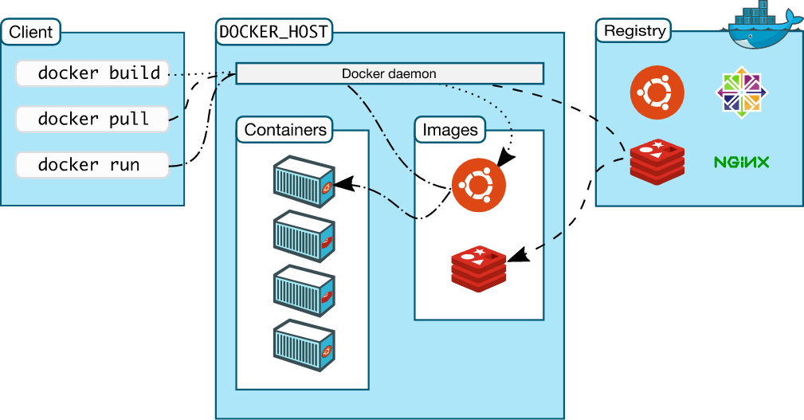
Docker Architecture

Slide 4
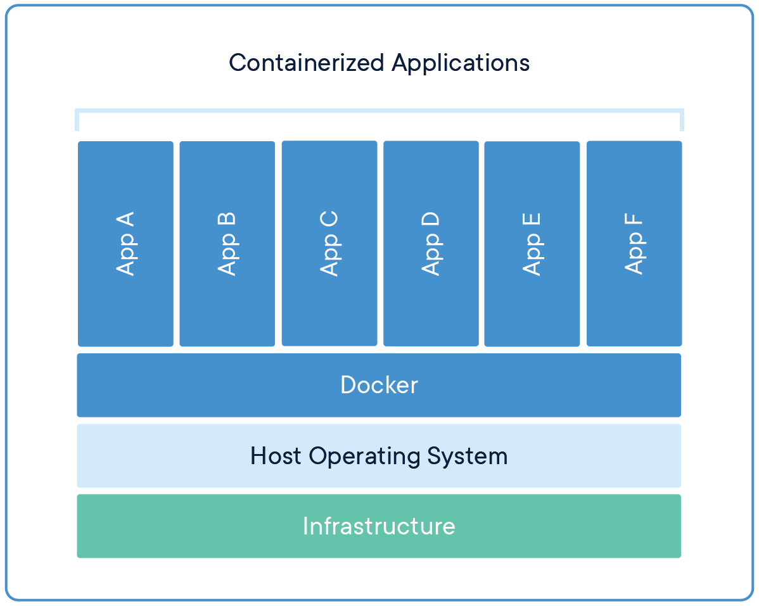
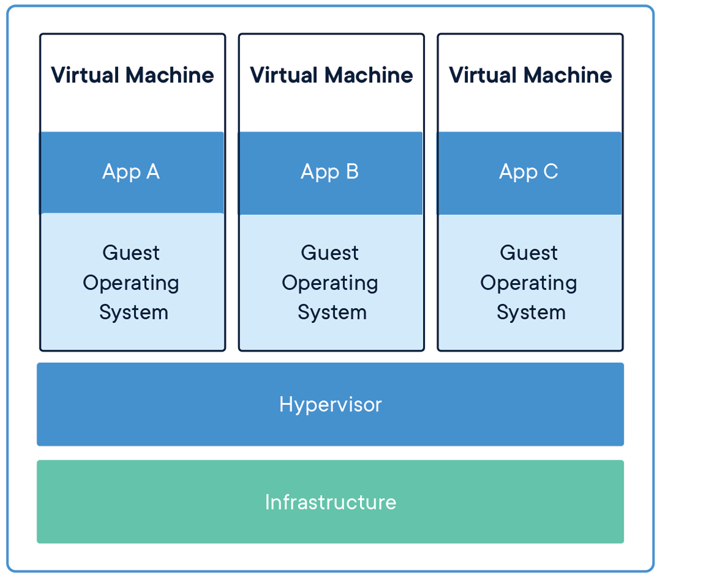
Docker Vs Virtual Machine

Slide 5
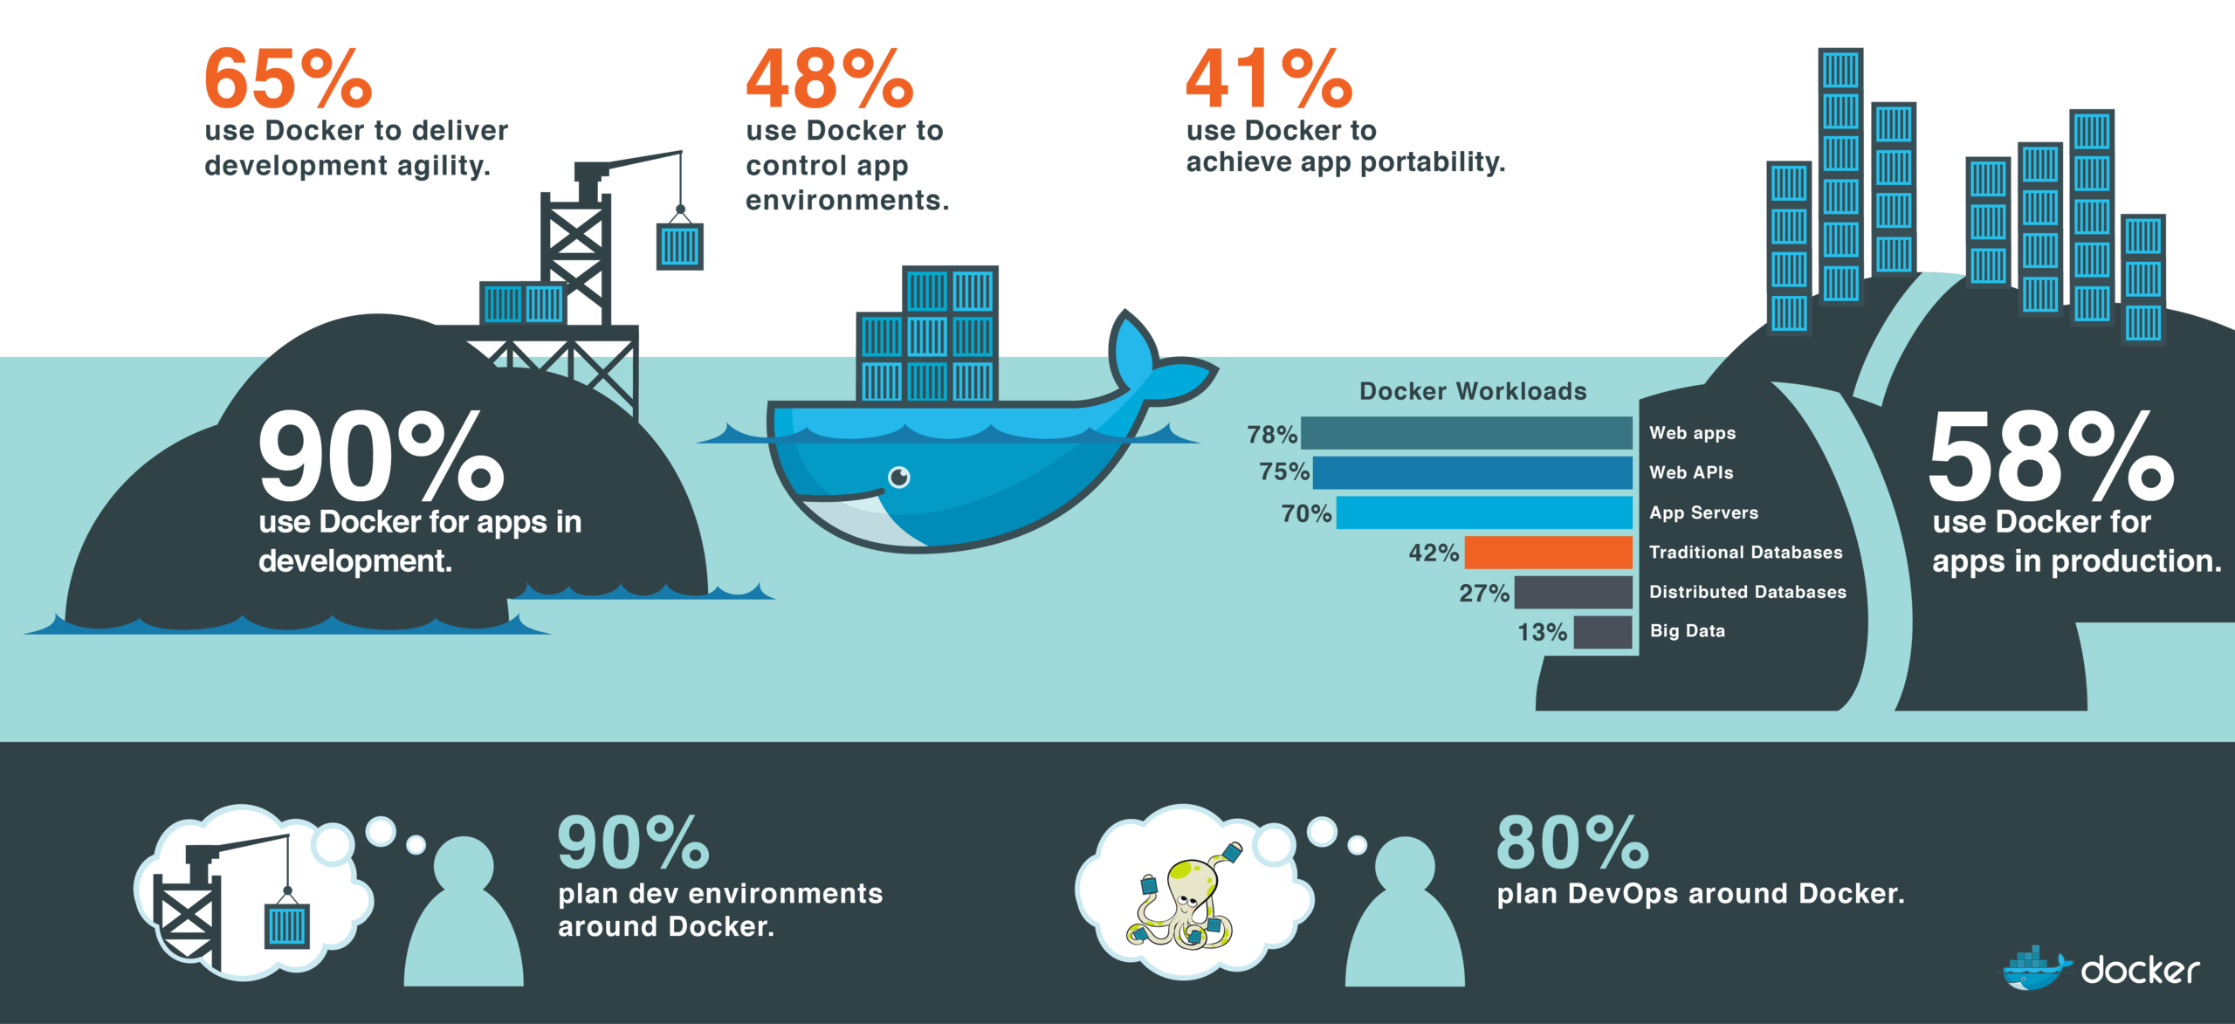
Why Docker

Slide 6
Docker commands
Go to the place where the dockerfile and type this command to build the image:
docker build -t crossworkers/googletest .
To check image creation use :
docker images
To run the image use:
docker run –v “the desired working directory”:/mnt –w /mnt imagename make
Example: docker run -v D:/work/training/googletest/mnt:/mnt -w /mnt crossworkers/googletest:latest make
Interactive shell: docker run -it D:/work/training/googletest/mnt:/mnt -w /mnt crossworkers/googletest:latest bash

Slide 7
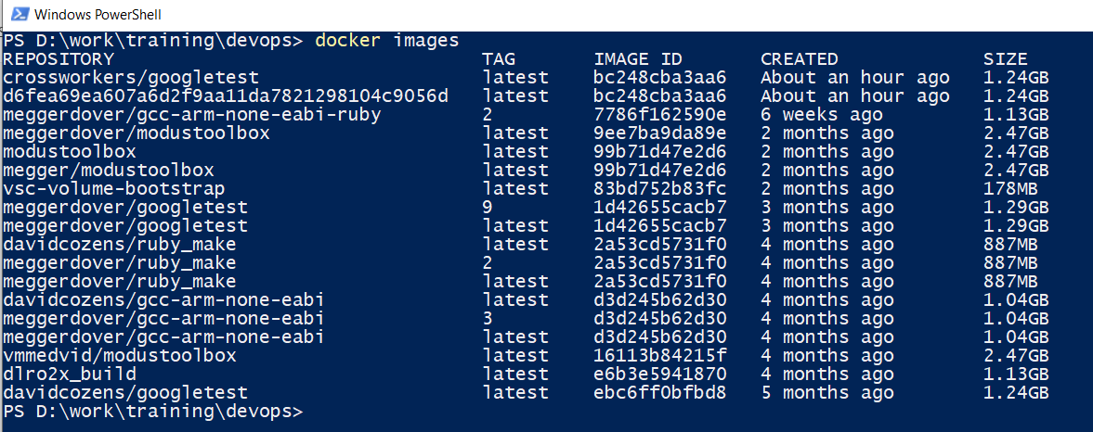
Docker Image

Slide 8
Docker hub
https://hub.docker.com/search?q=&type=image
https://github.com/Mohamedsaied8/devops

Slide 9
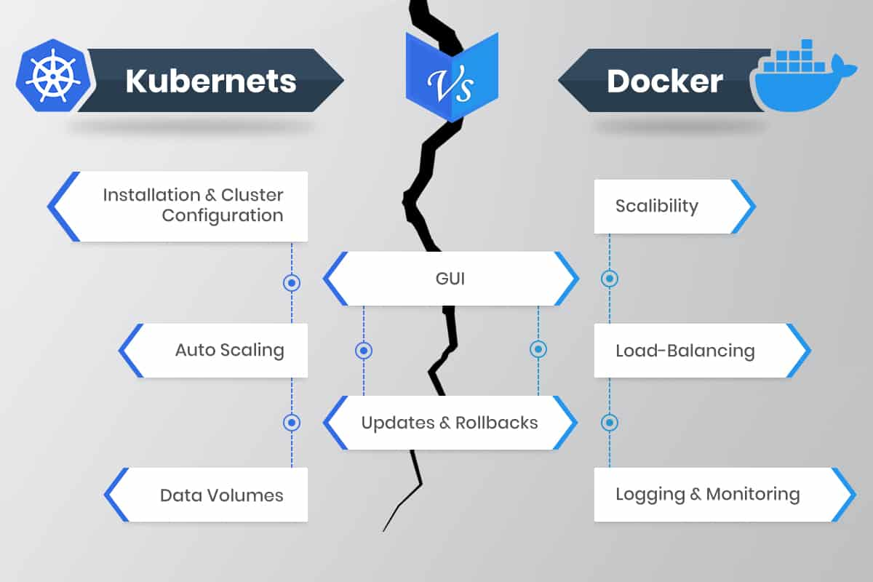
Docker Orchestration
Kubernetes
Docker Swarm

Slide 10
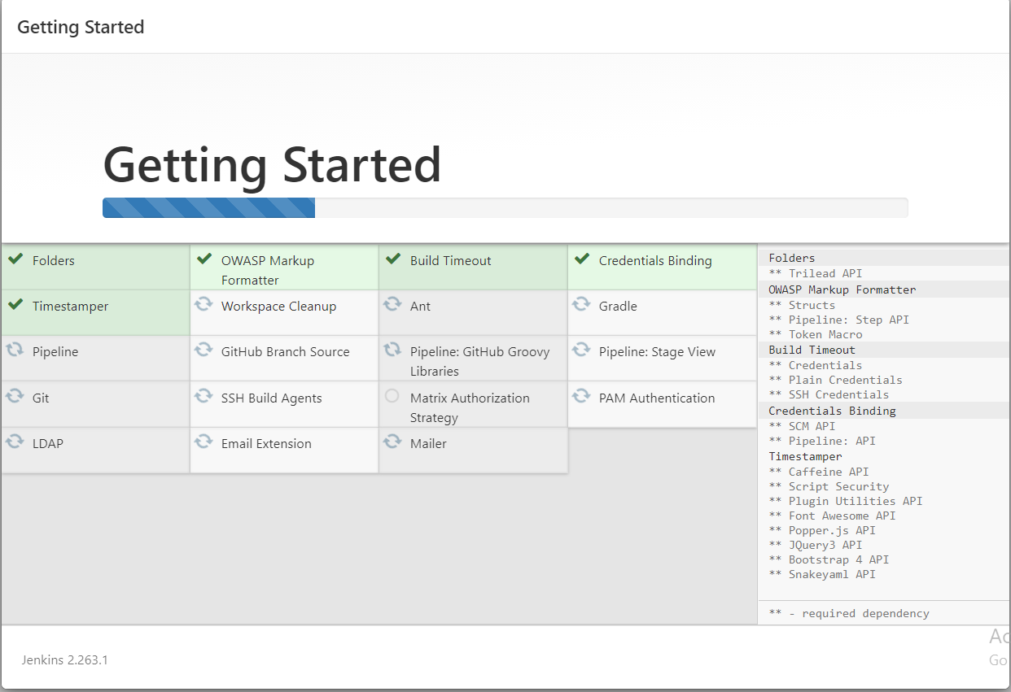
Jenkins plugins

Slide 11
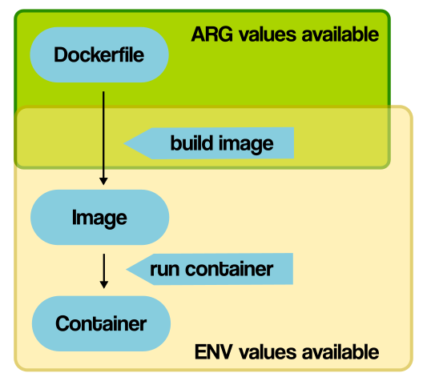
Arg vs env

Slide 12
Thank you.

